Slide 1










Whiteboardmaths.com
7
2
1
5
© 2004 All rights reserved

Slide 2
Decimal Places (Rounding)
Numbers can be rounded to 1,2, 3 or more decimal places.
Rounding to 1 d.p
4 . 8 3 2 5
4. 8 4 2 5
4. 8 5 2 5
5 or bigger ?
5 or bigger ?
5 or bigger ?
No
No
Yes
4.8
4.8
4.9

Slide 3
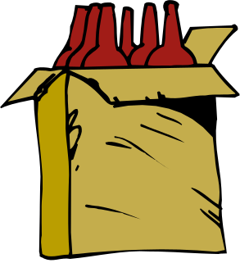
Decimal Places
It is often necessary/convenient/sensible to give approximations to real life situations or as answers to certain calculations.
For example if a case of wine containing 6 bottles costs £25 then you could price a single bottle by calculating £25 ÷ 6 = £4.166666667. It would be pointless to write out all the numbers on your calculator display. Since we are dealing with money (pounds and pence) we only need 2 decimal places (2 d.p.) So it would be much better to write down £4.17.

Slide 4
Rounding to 1 d.p
4 . 8 3 2 5
4. 8 4 2 5
4. 8 5 2 5
5 or bigger ?
5 or bigger ?
5 or bigger ?
No
No
Yes
4.8
4.8
4.9
4. 8 6 2 5
4. 8 7 2 5
4. 8 9 2 5
5 or bigger ?
5 or bigger ?
5 or bigger ?
Yes
Yes
Yes
4.9
4.9
4.9

Slide 5
Rounding to 2 d.p
5. 8 4 2 5
1. 4 2 6 1
0. 6 0 8 3
5 or bigger ?
5 or bigger ?
5 or bigger ?
No
Yes
Yes
5.84
1.43
0.61
0. 2 9 4 3
0. 5 5 5 0
0. 3 9 7 0
5 or bigger ?
5 or bigger ?
5 or bigger ?
No
Yes
Yes
0.29
0.56
0.40

Slide 6
Rounding to 3 d.p
5. 8 4 2 5 4
1. 4 2 6 1 8
0. 6 0 8 3 4
5 or bigger ?
5 or bigger ?
5 or bigger ?
Yes
No
No
5.843
1.426
0.608
6. 2 9 4 7 1
5. 4 0 0 9 7
0. 3 9 9 7 7
5 or bigger ?
5 or bigger ?
5 or bigger ?
Yes
Yes
Yes
6.295
5.401
0.400

